Slide 1

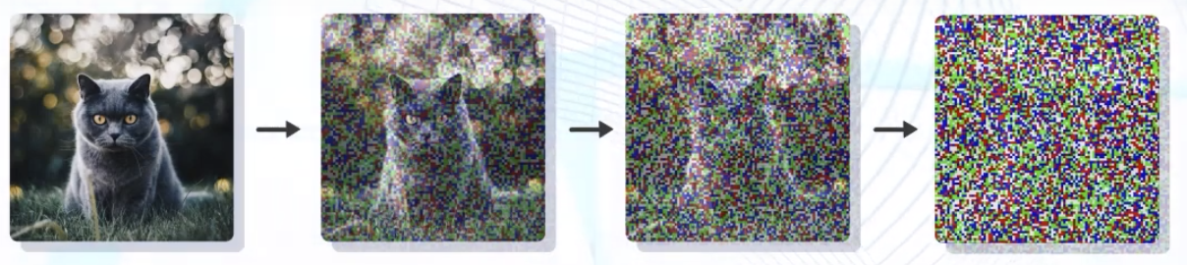
Stable Diffusion: Intuition
Forward Diffusion
X₀ X₁ X₂ ……… X_{T}
Reverse Diffusion
Forward Diffusion is Noising
Reverse Diffusion is Denoising
Note: X₀ is Denoised Image, X_{T} is Image with added Noise T times.

Slide 2
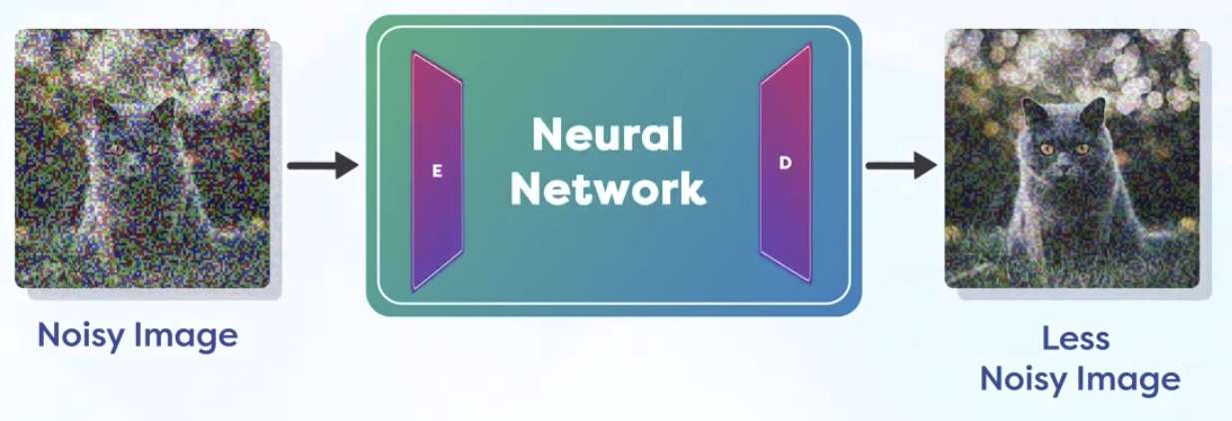
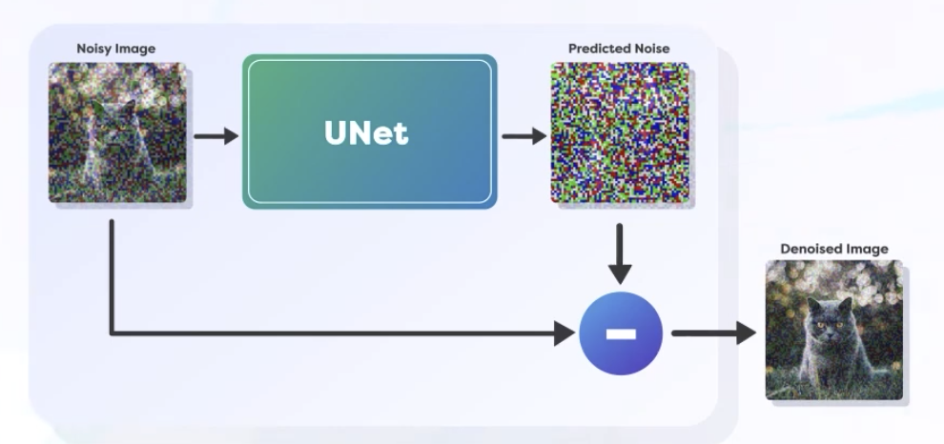
Stable Diffusion: Purpose
At Every Step of Reverse Diffusion, We want to:
Calculate the Noise on Current Image
Remove the Noise from Current Image
Repeat
So, Stable Diffusion is:
C ⇒ R ⇒ R
Noise is calculated easily with Neural Networks, Unet is popular network for the same. UNet?? WTH??
We cannot estimate all the error in one step, we do it slowly and Diffusion Process remains “Stable”. Too fast and big of change causes “Instability”.

Slide 3

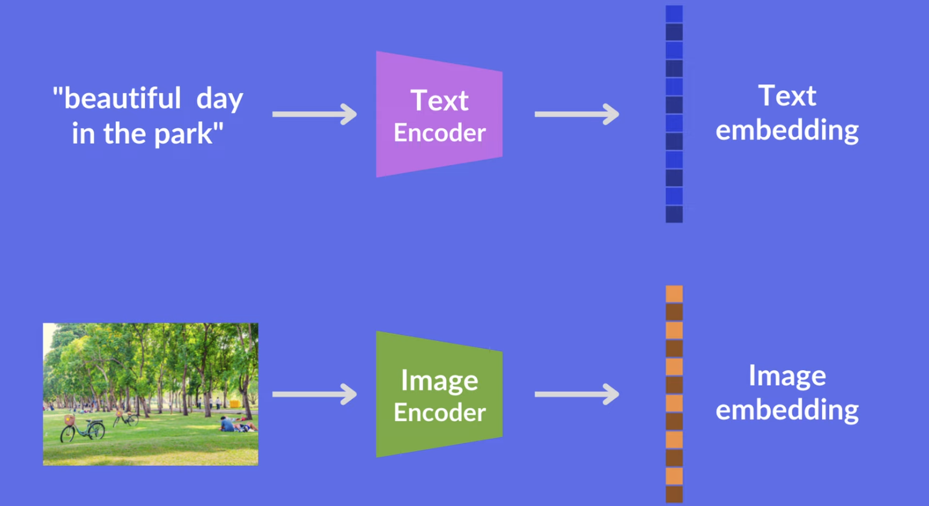
OpenAI CLIP: Revisit
So, when we say, CLIP model is trained, it means: Text and Image Encoders are able to encode Texts and Images into their respective embeddings, where Contrastive Loss is minimized between embeddings.
WHT!! Contrastive Loss!!

Slide 4
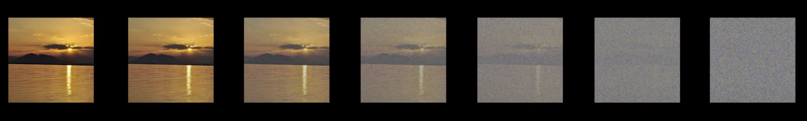
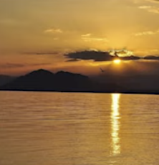

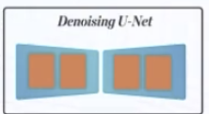
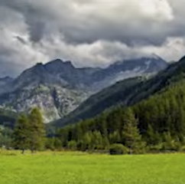
Stable Diffusion: How it all Fits In?
Training: We add noise by known amount and try to denoise it as per text. Do it Millions of times.
Inference: We just reduce noise from random noise slowly as per text. Keep doing it until denoised image is as expected.
This process is Called: DDPM: Denoising Diffusion Probabilistic Model.
DDPM Paper Link: https://arxiv.org/abs/2006.11239
Training
Inference

Slide 5
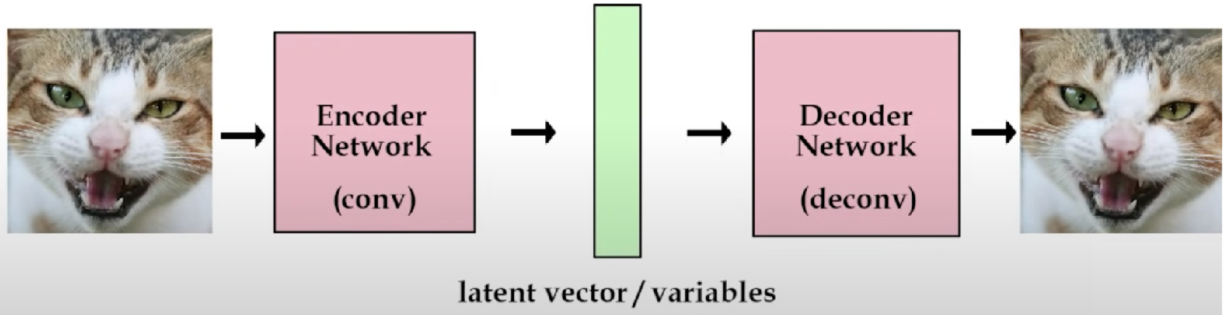
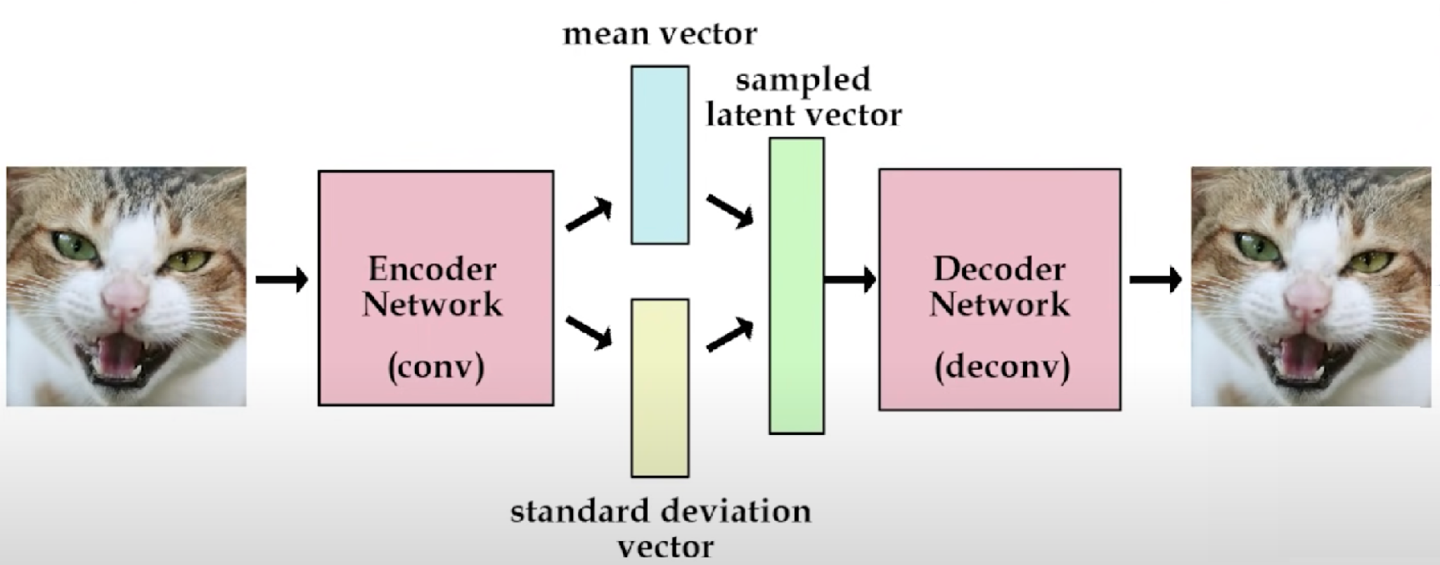
Paper: Variation Auto Encoder(VAE)
Traditional Autoencoder
Additional in Variational Autoencoder
Variational Autoencoder
Reconstructions Loss
Data Distribution Loss from Gaussian

Slide 6
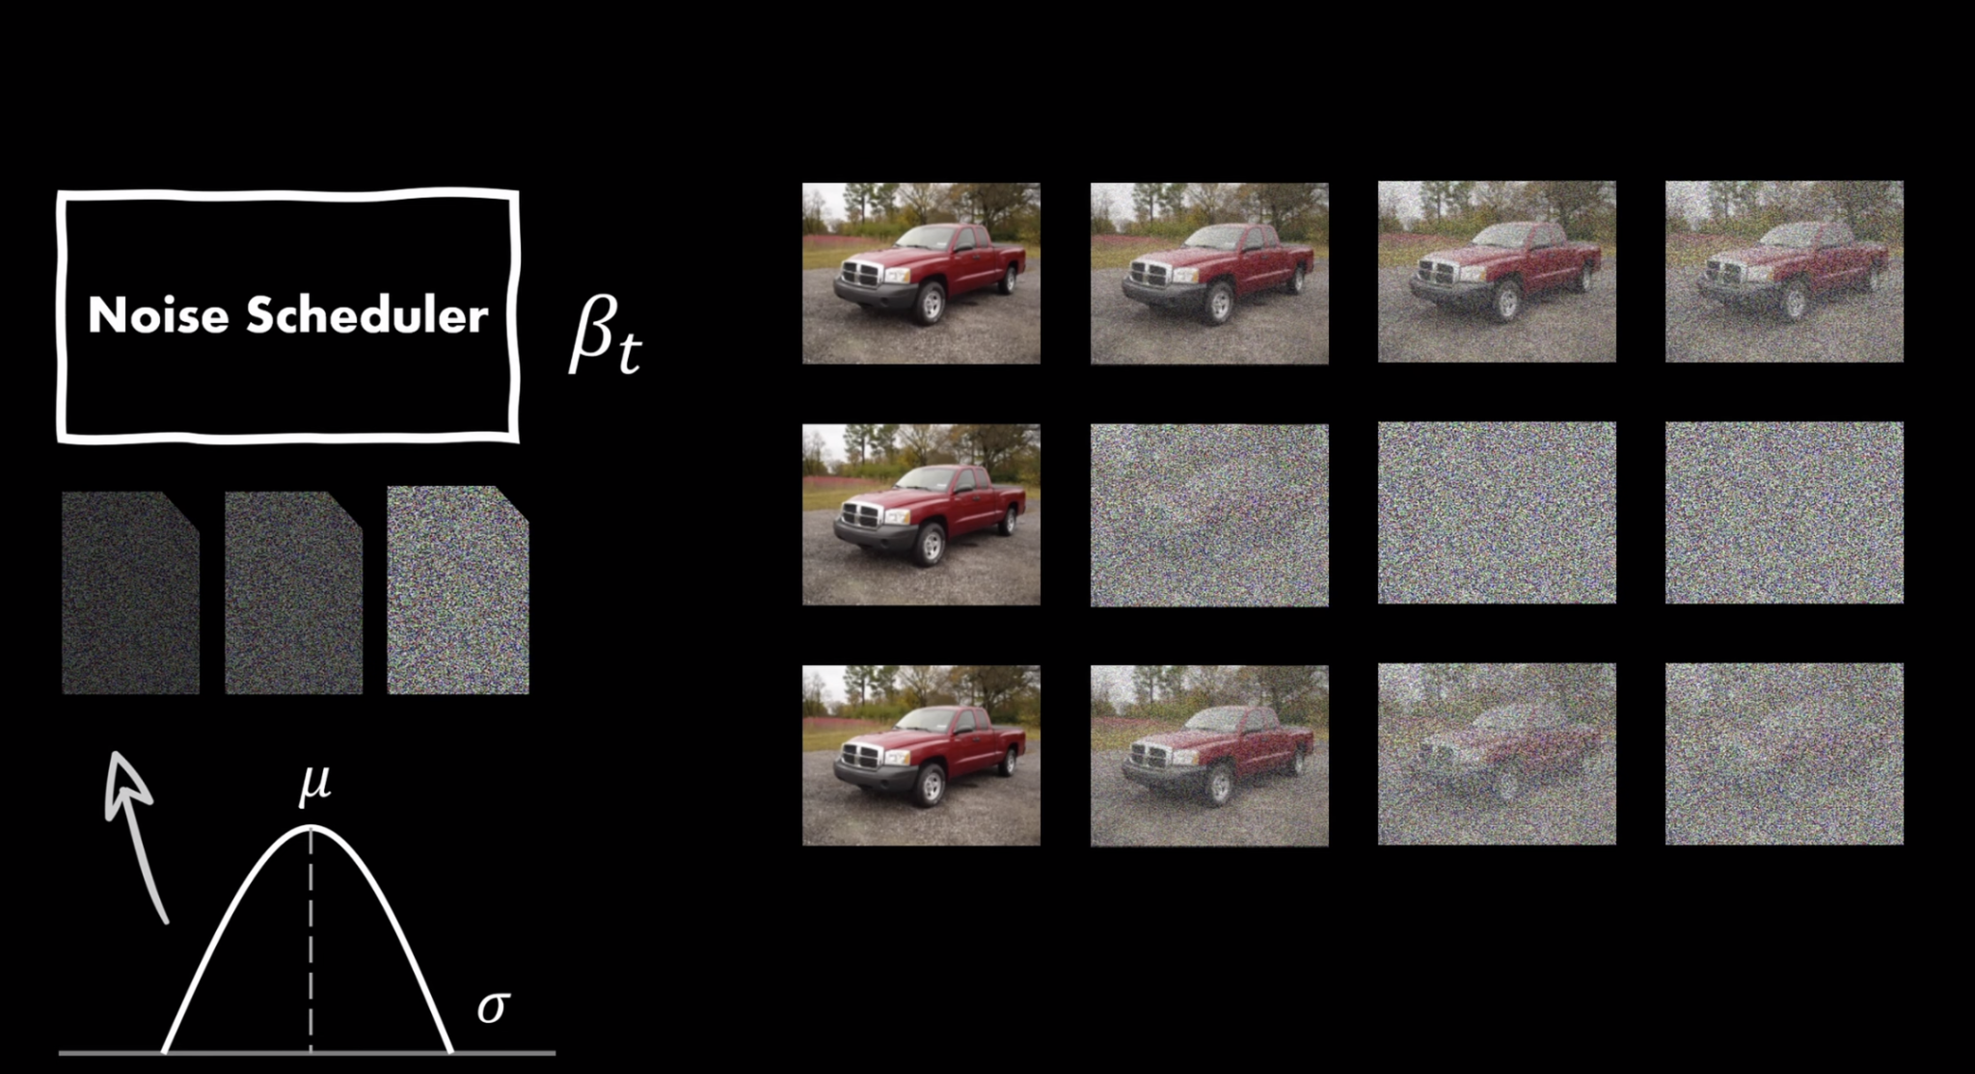
Stable Diffusion: Noise Schedule
In Forward Process, Target of Adding noise is to: Move toward Perfect Gaussian Noise Image with μ = 0 and σ = 1.
Noise Schedule matters a lot as it determined if images see by the model become: Too Noisy, Too Early
Many Noise Schedules are discussed in paper as: Sinusoidal, Quadratic, Linear
We will use Linear Noise Schedule.

Slide 7
Experiments: Use what we learned
With Knowledge of Diffusion Model and CLIP Text and Image Embedding, We can play around with some basic Image generation and get a feel for: CLIP Text Encoders. Hugging Face Spaces. Hugging Face Diffusers Library.
Before fiddling with Code, remember: Latents Text Embedding Image Embedding Diffusion Process across Timestamps

Slide 8
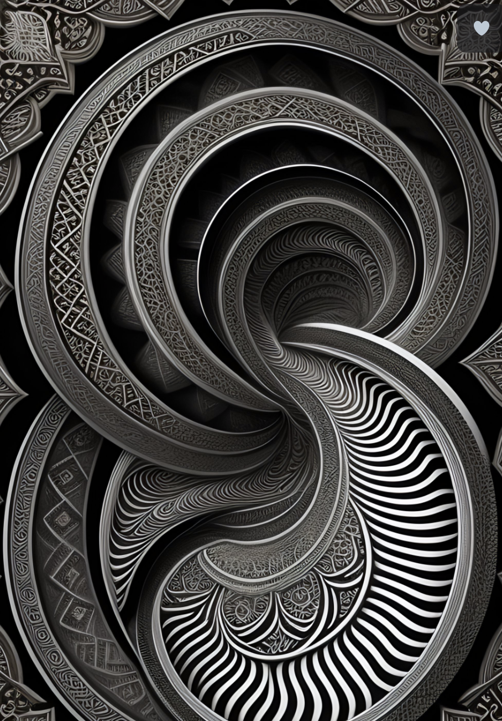
Train or Fine Tune?
2 Options: Train: From Scratch, Fine-Tune: Foundational Model
So? Well, it depends, Answer is: Yes and No! Yes: if you are forced to by factors No: Almost Always, Fine-Tune!
Factors, which might force you to train from scratch:
Text Prompts need to be very specialized.
Need to create new and original concepts in images. E.g. All Possible Types of lesions in X-Ray Images.
Not so favorable Copyright or Compliance of foundation models.
Not enough resources like: Money, Time, Human Capital for Evaluation etc.

Slide 9
DreamStudio and StableStudio: Blessings of Stable Diffusion
How you want to consume tools provided by Stability.ai:
Basic Text to Image: (No Code Option) - Runs on public CPU - Very Slow! https://huggingface.co/spaces/stabilityai/stable-diffusion
Hugging Face diffusers library: (Write Python Code) - Run on own GPU setup.
DreamStudio: StabilityAI’s paid Image Generation platform. https://dreamstudio.ai/
StableStudio: StabilityAI’s Open Source Image Generation tool. Exactly like DreamStudio, But will have to run on own infrastructure.
Stable Diffusion WebUI by Automatic1111: Best of both world. https://github.com/AUTOMATIC1111/stable-diffusion-webui Build on open source and lets you customize the code as per need.
We will use this!

Slide 10

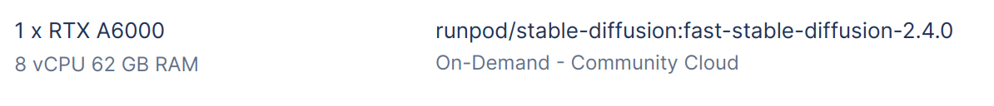
RunPod: Run Stable Diffusion WebUI
Hope Everybody has RunPod instance running.
Go to RunPod Instance and Upload/Open the notebook named:
Module_4_Stable_Diffusion_WebUI_A1111.ipynb
Run the whole Notebook from top to bottom. (It might take 15 minutes for whole thing)
Click on the HuggingFace Gradio App Link. (Let the Notebook be running)
Make Sure to Terminate the RunPod Instance after use.

Slide 11
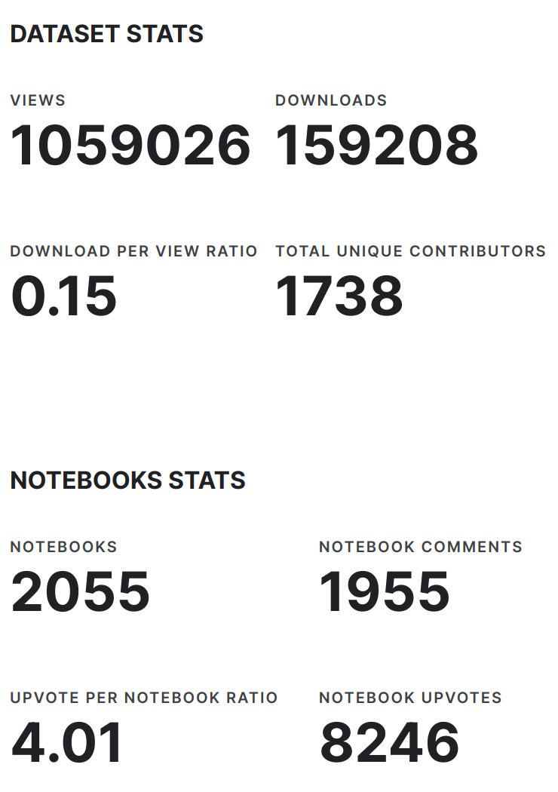
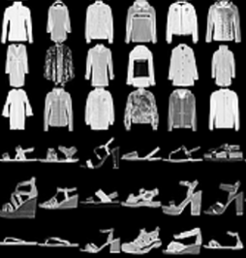
Diffusion Model: Fashion MNIST Dataset
Very Popular Toy Dataset to benchmark algorithms.
Available in TorchVision by default.
Dataset has: - training set of 60,000 examples - test set of 10,000 examples.
It is derived on the theme of MNIST dataset of handwritten images.
We use this dataset to create a Diffusion model, which can create fashion articles gray images from Gaussian random noise.

Slide 12
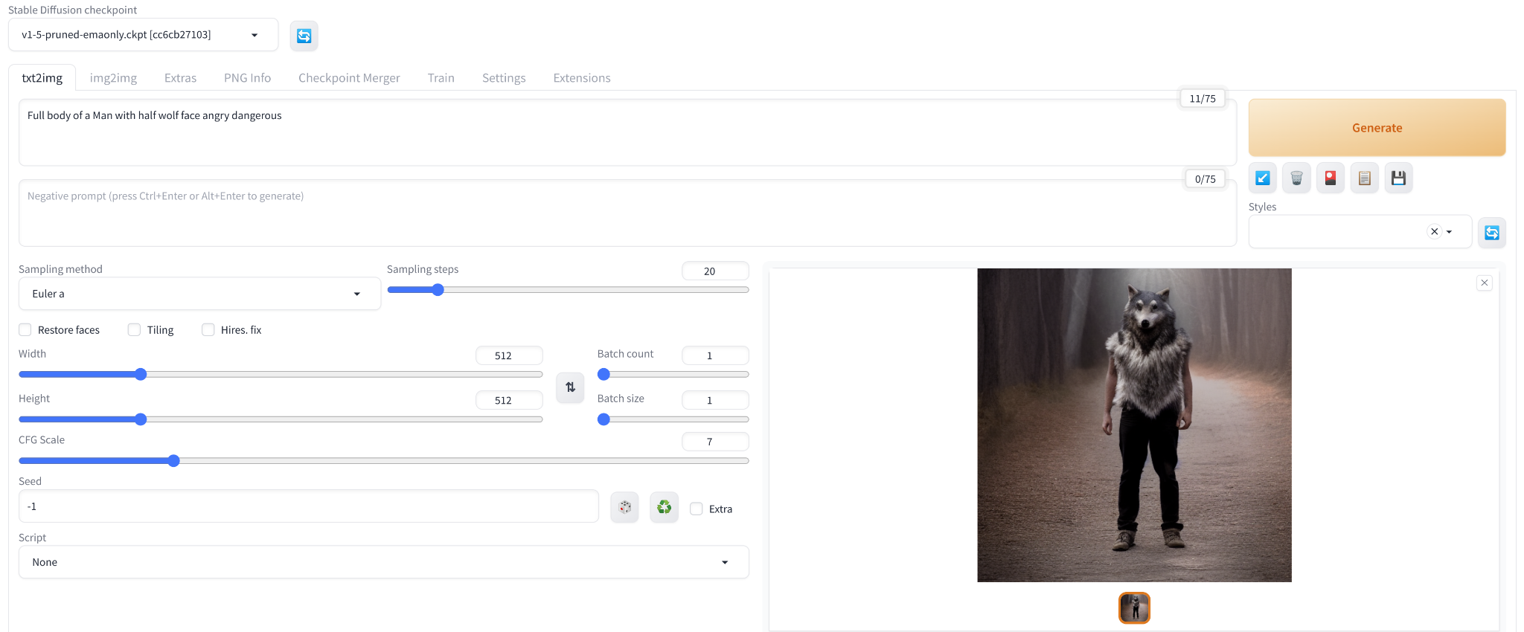
Stable Diffusion WebUI: Great Intuition in UI
Simple UI
Easily Extensible

Slide 13
Resume The Workshop
From Module 4 - Slide 12
Get Everyone at Slack Workspace: appliedai-tbx9444.slack.com https://app.slack.com/client/T05M42BPRV0/C05LXCNL32A
Module 5 - End to End

Slide 14
More Deep Dive in the Concepts by Code
Let’s Go To The Collab: Module_3_Stable_Diffusion_Deep_Dive.ipynb

